Slide 1



Secure 360
Secure Your Payments
Team : Access Denied

Slide 2


CONTENTS
1
INTRODUCTION
2
PROTOTYPE
3
WORKING
4
CONCLUSION

Slide 3


Smart Secure Authentication
Introduction

Slide 4


Problem Statement
Presently, most of the digital payments are authenticated by a Personal Identification Number (PIN)/password/CVV followed by a One-Time Password (OTP) which is received by the remitter over his mobile phone. While the SMS through which the OTP is received is not encrypted, the instances of digital payment frauds where the users are tricked into sharing the OTP have also been observed. As such, an alternate smart secure authentication mechanism may result in more secure digital transactions.
Here comes the solution

Slide 5
Situation Analysis
Telangana
525
Maharashtra
229
Andhra Pradesh
140
PPT模板 http://www.freeppt7.com/moban/

Slide 6

Short Description
01
Initialize payment
02
Get your Unique Bar Code
03
Type your 8–12-digit security pin using our authenticator app

Slide 7
Secure 360
Prototype

Slide 8
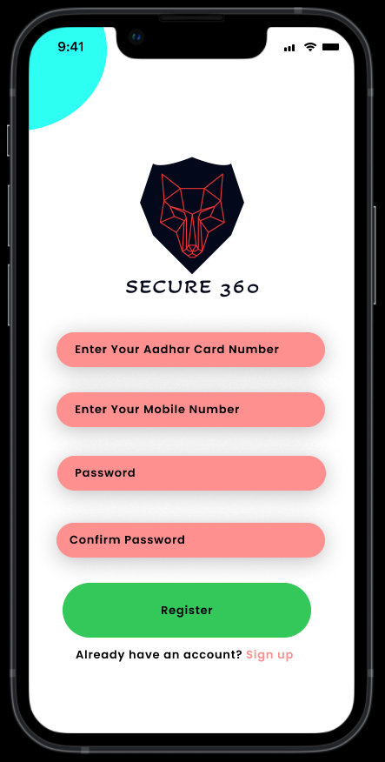

Secure 360 APP
This Authenticator app generates an 8-12 digit encrypted security pin and notifies every activity of digital transaction. That security pin will consist of A-Z, a-z, 0-9, @, # and $. The total number of pins possible is ${66}^{12}$. So there is less chance of any kind of Cyber Attack

Slide 9

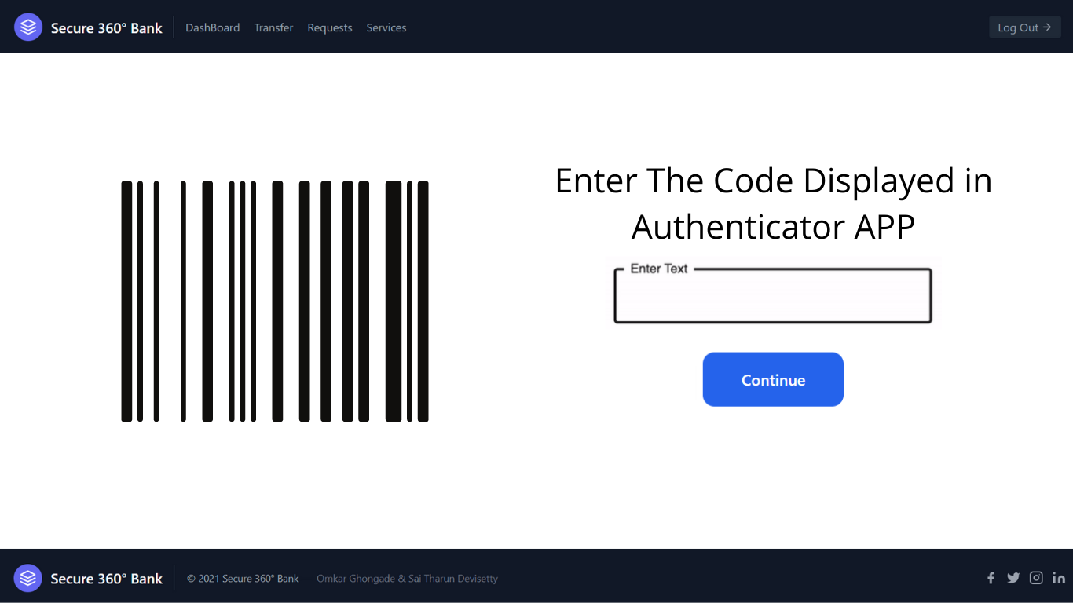

Secure 360 Bank Web Page
This is the page where there is 1st level of security. In this the user needs to open the app and enter the code displayed there and if it matches with the barcode then it will take him to the next step of payment
else after 5 wrong attempts it will give an alert in the app.

Slide 10
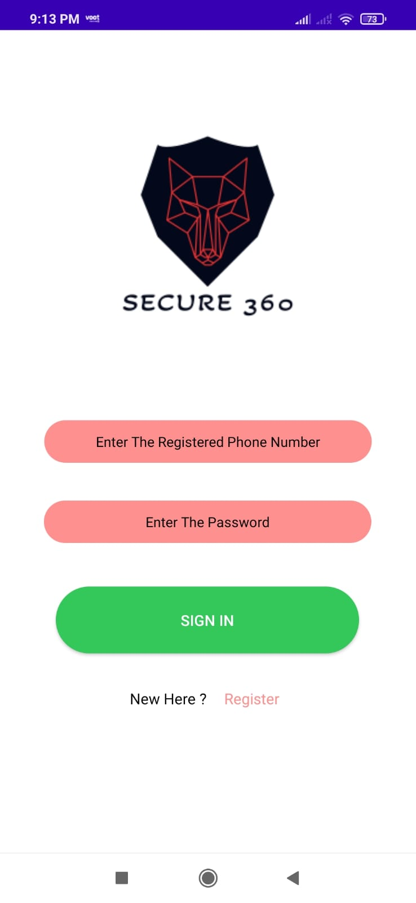

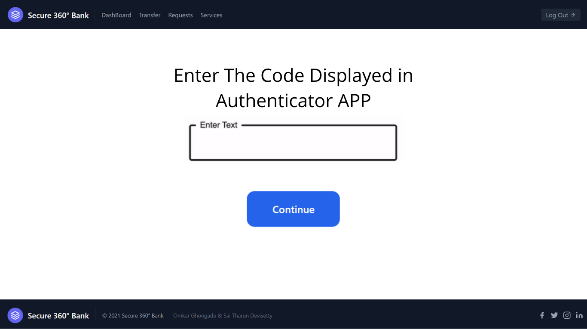
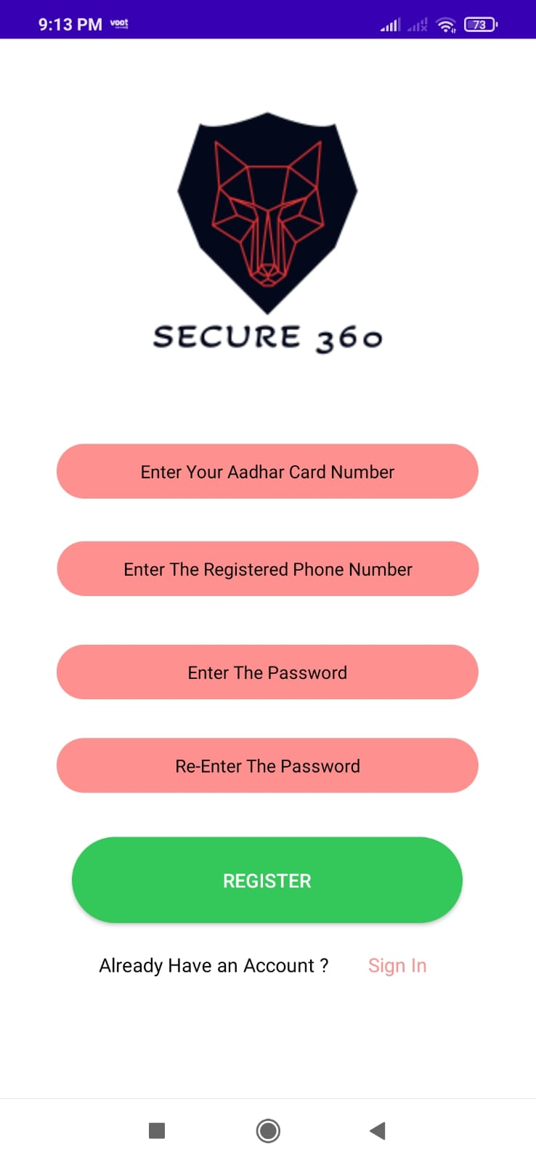
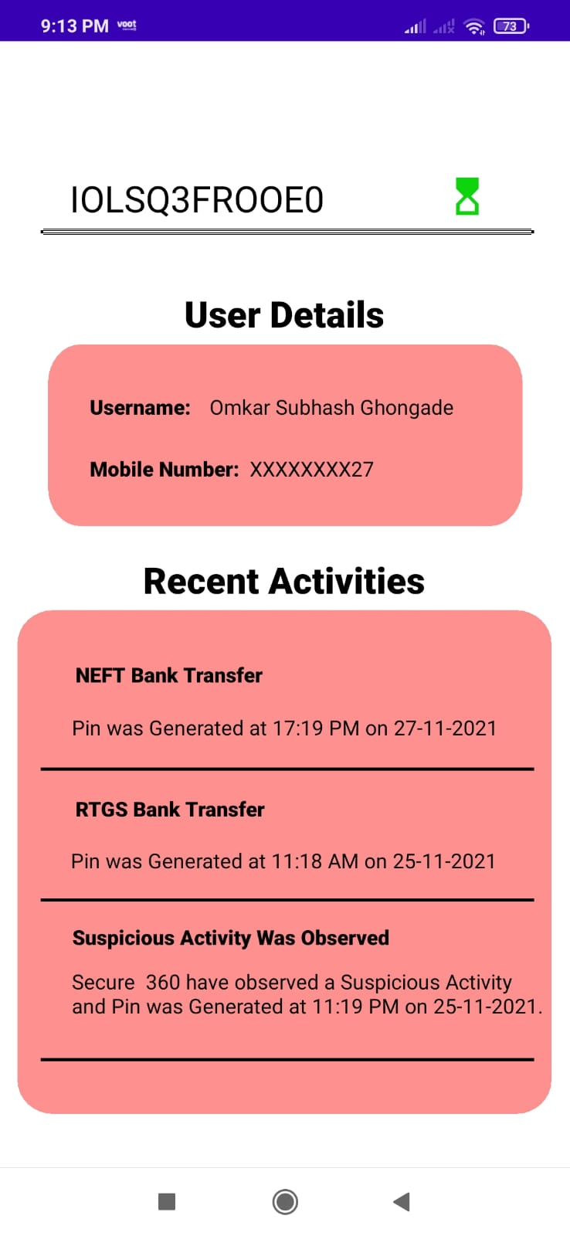
Templates Of Prototype
content

Slide 11
Working
Basic Working Of Our Prototype

Slide 12
Mobile Based APP

Slide 13
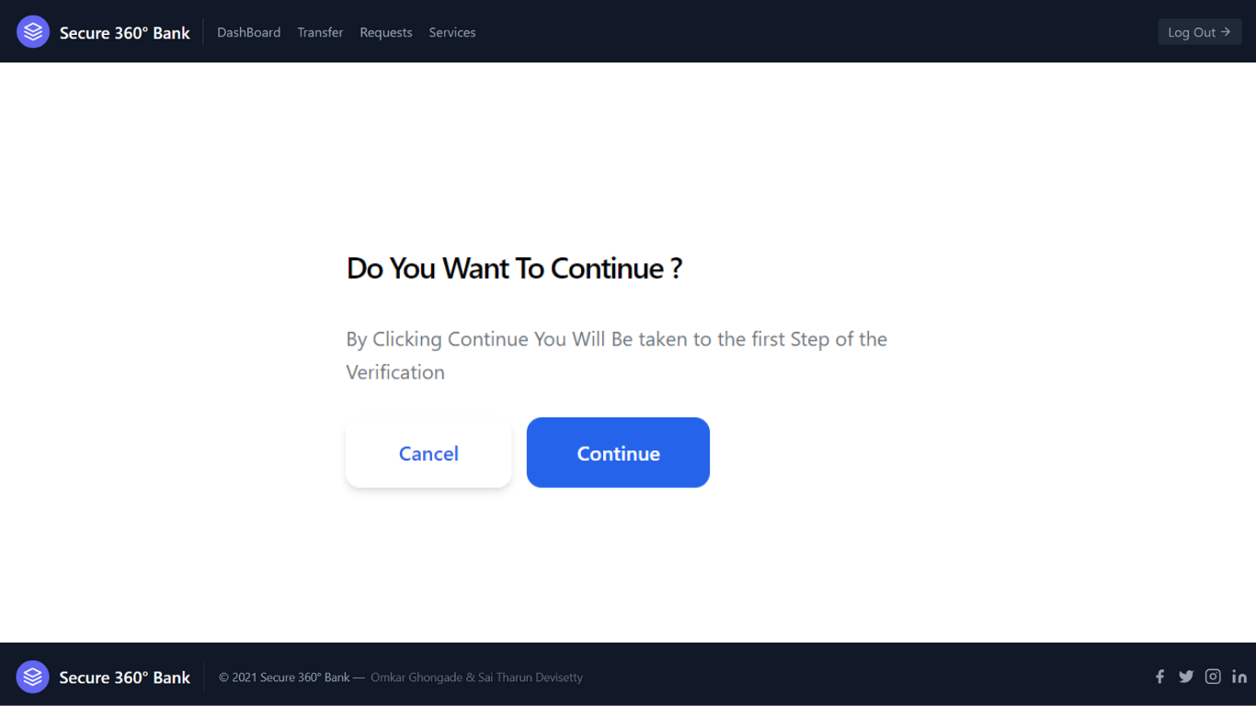
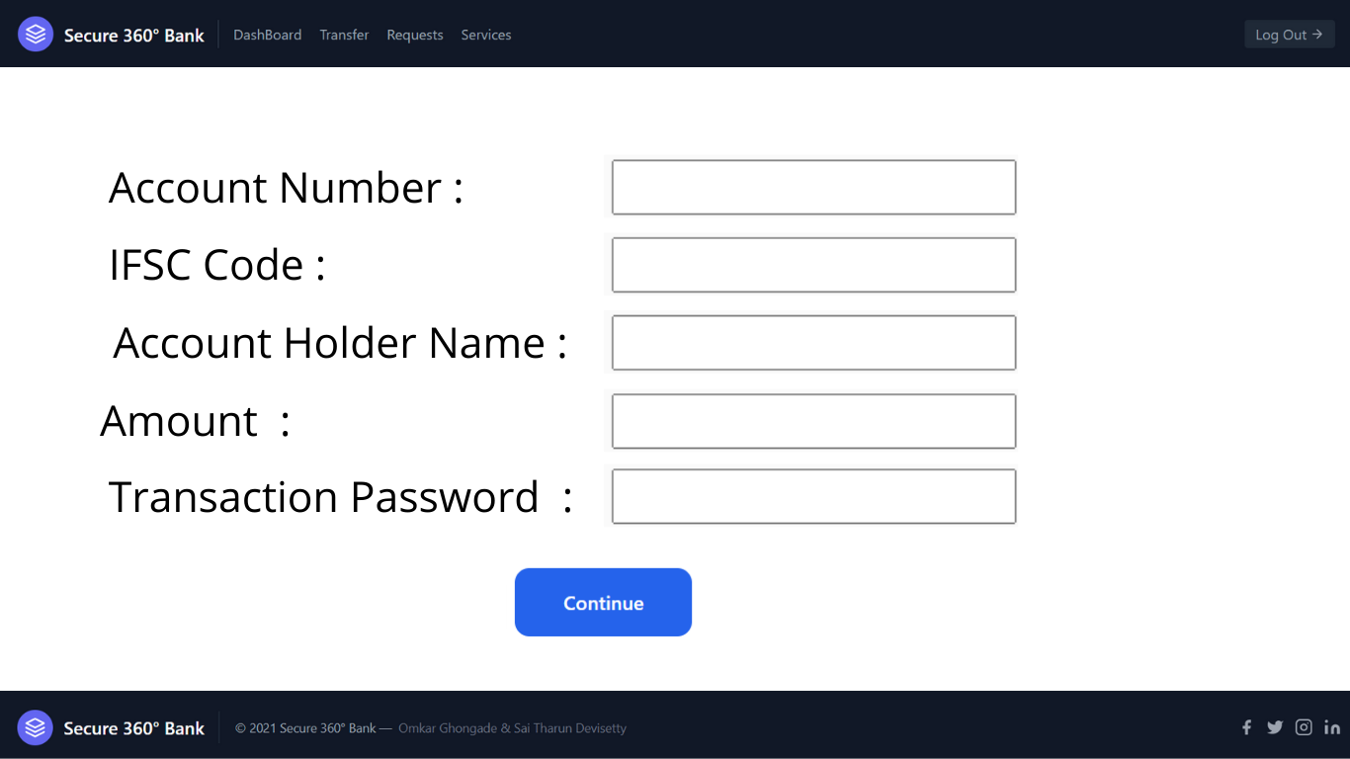
Web Based APP

Slide 14
Conclusion
Most Secure Solution

Slide 15
Why Our Solution is Best
01
02
03
04
Your data will be stored using the Hash Functions and the Cryptographic Algorithm
In total there will be combinations of pin possible, so in this case there will be less threat of any cyber attack
There is no risk of losing money as there we have removed the OTP step, so there will be less frauds
There will no case of data breach in this case as the hash functions will have the key of 128 bit length.

Slide 16
THANK YOU
GitHub: bit.ly/3DVUZQR
.

